Slide 1

ADVAnce C++

Slide 2
MODERN C++
Introduction To std::vector
std::vector V/s std::array
Declaring The Vector
Initializing The Vector

Slide 3
Introduction to vector
A vector is a dynamic array with automatically handled storage.
The elements in a vector can be accessed just as efficiently as those in an array with the advantage being that vectors can dynamically change in size.
In C++ , to use a vector we need to use the templated class called std::vector available in the header file called <vector>.

Slide 4
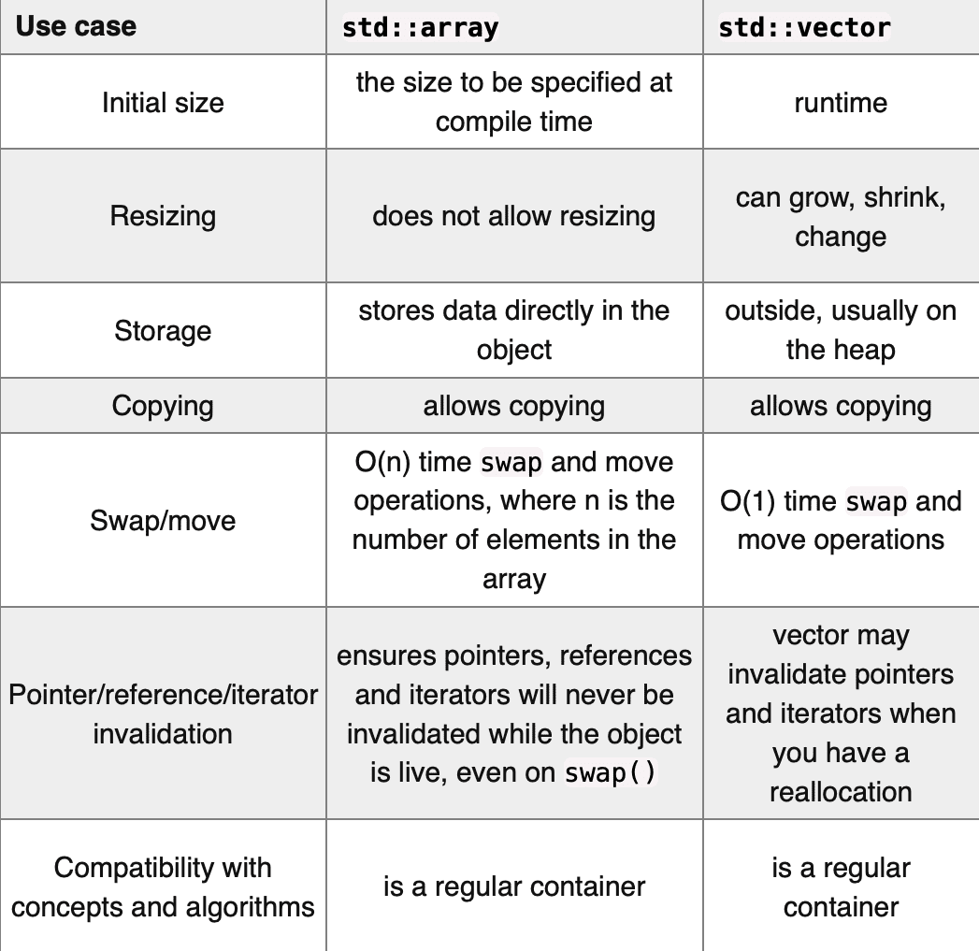
std::array v/s std::vector

Slide 5
declaring a vector
The declaration syntax of std::vector is the same as that of std::array, with the difference that it is not compulsory to specify the size along with the data type as shown below:
Syntax:
vector<datatype> vector_name;
Example:
vector<int> myvector;

Slide 6
Other ways
If needed we can provide the initial size to the vector while declaring it as well as an initial value to be filled in all the cells.
Syntax:
vector<datatype> vector_name(size);
vector<datatype> vector_name(size,value);
Example:
vector<int> v1(5);
// vector of size 5 ,with all values set to 0
vector<int> v1(5,10);
// vector of size 5 ,with all values set to 10

Slide 7
Initializing a vector
C++ provides us 3 popular ways to initialize a vector along with the declaration and they are:
Using List Initialization
Using Copy Constructor
Using Range Constructor

Slide 8
Initializing a vector
Using List Initialization: From C++11, we can use the initializer lists '{...}' to initialize a vector.
Syntax:
vector<datatype> vector_name{val1, val2,. . ,val n};
vector<datatype> vector_name={val1, val2,. . ,val n};
Example:
1. vector<int> v1{10,20,30};
2. vector<int> v2={10,20,30};
3. vector <int> v3;
v3={10,20,30};

Slide 9
Initializing a vector
Using Copy Constructor: We can use a copy constructor to initialize the vector from another vector elements:
Syntax:
vector<datatype> vector_name(other_vector);
Example:
vector<int> v1{10,20,30};
vector<int> v2(v1);

Slide 10
Initializing a vector
Using Range Constructor: We can use a range constructor to initialize vectors from elements of an array or another container.
Syntax:
vector<datatype> vector_name(start_addr,end_addr);
Example:
1. vector<int> v1{10,20,30};
vector<int> v2(v1.begin(),v1.end());
2. int arr[]={10,20,30};
vector<int> v3(arr,arr+sizeof(arr)/sizeof(int));

